Slide 1
Angular 8 - Day 6
Defining Observables, Material, Route Guards and Pipes

Slide 2
Vignesh Murali Natarajan (119780), Edited by Jason Monroe (688776)
Veteran Trainer, Project Manager and Solution Architect with 14 years of technical training experience and 12 technical certifications on Java, Mobile, Web, Architecture, Design and Development
2.0, May 2019

Slide 3

Objectives
Defining Observables:
BehaviorSubject
asObservable()
next()
complete()
Angular Material
Installation
Login form
RouteGuards
Pipes

Slide 4
Scenario
We want to add a Login feature to our Developer App:
Login / Logout toggles on nav bar
Login Form for authentication
Create Bio is a guarded route
How do we accomplish this?
Observables

Slide 5
Scenario
Nav Bar
login/logout
Siblings
Login Component
(inside router-outlet)

Slide 6
Defining Observables

Slide 7
Observables
Defining an Observable:
Let data:any = new Observable(observer => {
setTimeout(() => {
observer.next(42);
}, 1000);
setTimeout(() => {
observer.complete();
}, 3000);});
Observable as a return Type:
getCountry(countryName: string):Observable<Country>{
//http get request
}
Subscribing/Listening to an Observable:
data.subscribe(
value => this.values.push(value),
error => this.anyErrors = true,
() => this.finished = true
); }

Slide 8
Observables
Observables Definition:
Includes defining an Observable object.
Supplying the Observable body. This is where asynchronous operations need to reside.
These asynchronous operations may communicate to subscribers via the following methods:
Observer. next – to send a progress signal with data.
Observer.error – to indicate errors.
Observer.complete – to indicate completion of the process.
All of the communication methods have the ability to send homogeneous data back to the subscribers.
The data type of the Observables has to be declared in advance, at the time of reference creation.

Slide 9
Observables vs Promises
Both Promises and Observables provide abstractions that help deal with the asynchronous nature of applications.
Some important differences include:
Observables can define both the setup and teardown aspects of asynchronous behavior.
Observables are cancellable.
Observables can be retried using one of the retry operators provided by the API, such as retry and retryWhen.
Promises require the caller to have access to the original function that returned the promise in order to have a retry capability.
https://stackoverflow.com/questions/37364973/promise-vs-observable

Slide 10
Observables Hot ‘n Cold
A Cold Observable is a durable messaging subscription.
Whatever messages are sent by the observable, are made available to the observer regardless of the fact that some of the events may have occurred in the past i.e., when the observable was not even subscribed.
This is more like replaying a recorded sequence of events, any time a new subscriber is added.
A Hot Observable on the other hand, takes time into strict consideration.
The events/data exchanged between the observable and the observer are only the current ones.
Past messages will not be resent to new observers just subscribing in.
Since hot observables are live streams with observers running the risk of losing signals, it has to be explicitly published by the observable which finalizes the Observable.

Slide 11
Observables Hot ‘n Cold (Contd.)
Cold Observable Example: Subscriptions A and B receive all messages, despite late subscription by Subscription B.
const obsv = new Observable(observer => {
setTimeout(() => {
observer.next(1);
}, 1000);
setTimeout(() => {
observer.next(4);
}, 4000);
});
// Subscription A
setTimeout(() => {
obsv.subscribe(value => console.log(value));
}, 0);
// Subscription B
setTimeout(() => {
obsv.subscribe(value => console.log(`>>>> ${value}`));
}, 2500);

Slide 12
Observables Hot ‘n Cold (Contd.)
Hot Subscription Example: Subscription B will lose out on the first message sent by the Observable.
Observe the usage of the publish and the connect methods for subscription broadcast.
const obsv = new Observable(observer => {
setTimeout(() => {
observer.next(1);
}, 1000);
setTimeout(() => {
observer.next(4);
}, 4000);
}).publish();
obsv.connect();
// Subscription A
setTimeout(() => {
obsv.subscribe(value => console.log(value));
}, 0);
// Subscription B
setTimeout(() => {
obsv.subscribe(value => console.log(` ${value}`));
}, 2500);

Slide 13
BehaviorSubject
In our scenario, we want the login link to trigger the login
Create an AuthService to house this function and subscribe to it from the Login Component
In order for the navbar links to switch, they need a third party to subscribe to.
BehaviorSubject and asObservable() to the rescue

Slide 14
BehaviorSubject
Subjects are wrappers for Observables
Add the ability to emit data in addition to being subscribed to
Use to retrieve data and send to all components that subscribe to it
BehaviorSubject requires a seed value and automatically sends the last emitted value on new subscription
In order to hide the observer side of a Subject, use asObsevable() method
https://www.learnrxjs.io/subjects/

Slide 15

Login Feature
Create an Auth Service (ng g s Auth)
Private BehaviorSubject initialized to false
Public authenticated property assigned BehaviorSubject asObservable()
Authenticate method that calls next(true) on authenticated property and also returns true
Logout method that calls next(false) on authenticated property
Create a new Login Component (ng g c Login)
Button in login.component.html that calls login method
Login method calls auth method in AuthService and navigates to ‘ ‘ if method returns true
Create login / logout links in navbar (app.component.ts)
Set up route in app-routing module
AppComponent subscribe to authenticated property of AuthService
Logout method in AppComponent that calls logout in AuthService
Notes:
Instructions to Trainer:
Instructions to Facilitator:

Slide 16
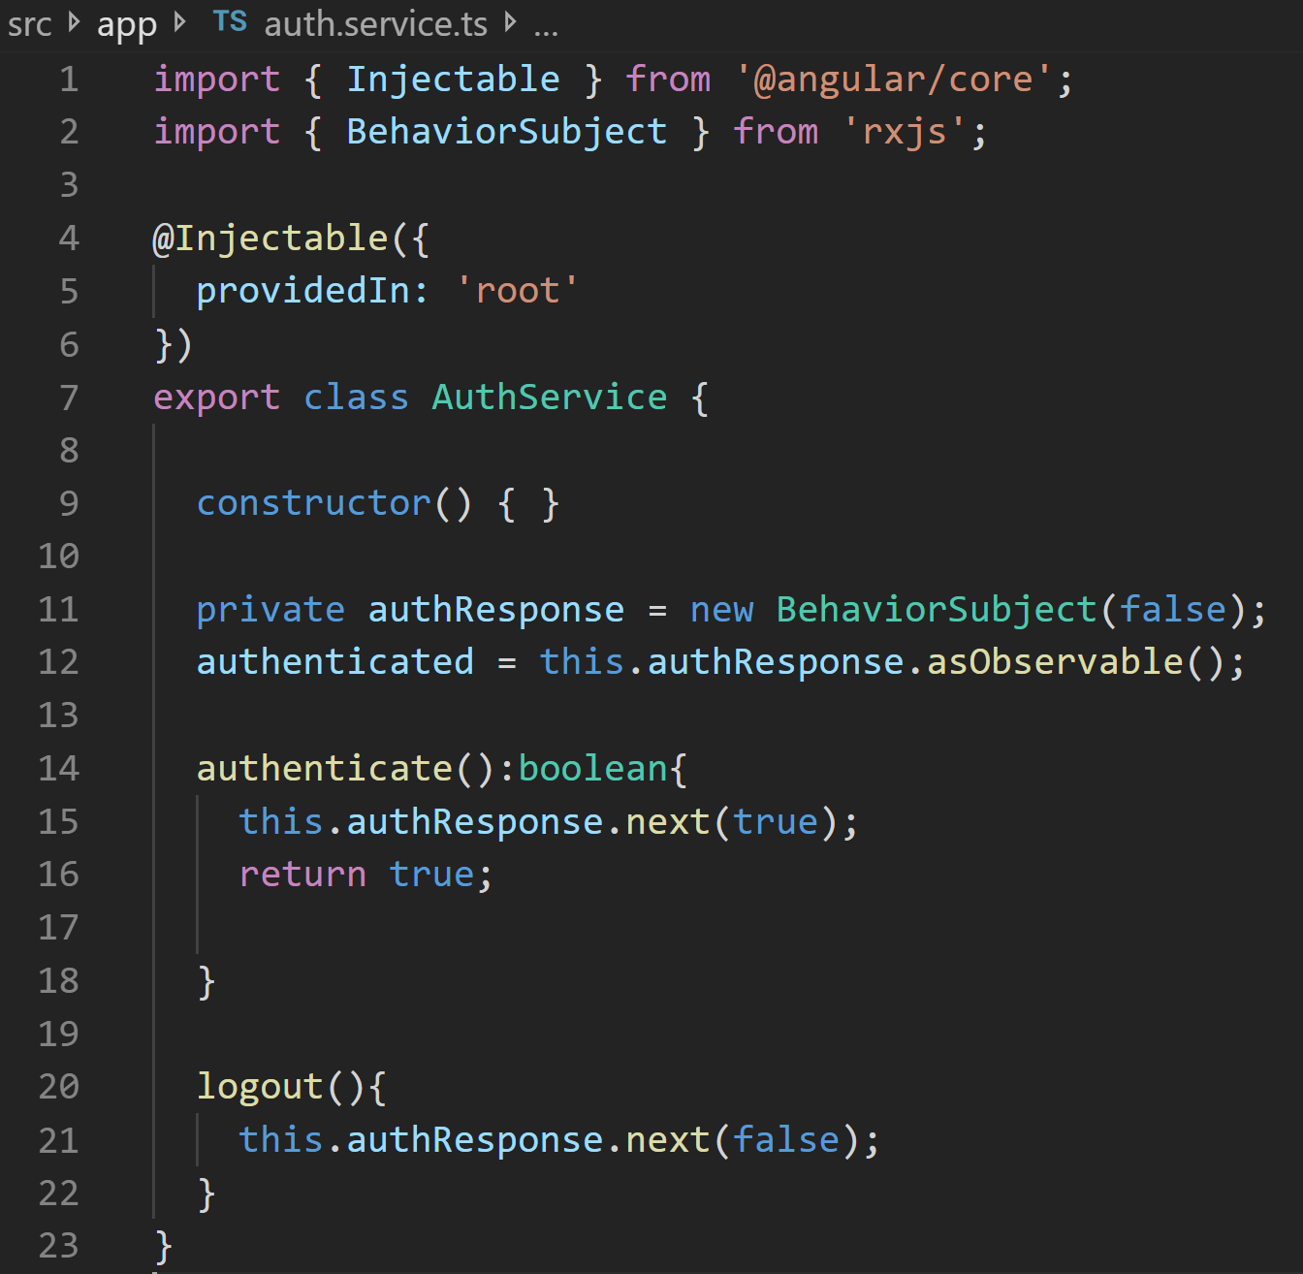
AuthService
#1
Notes:
Instructions to Trainer:
Instructions to Facilitator:

Slide 17
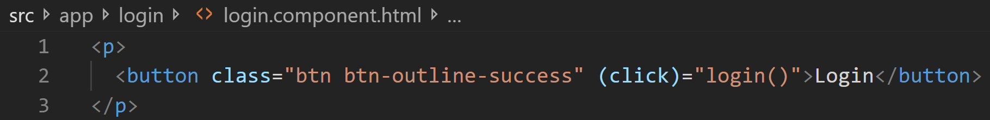
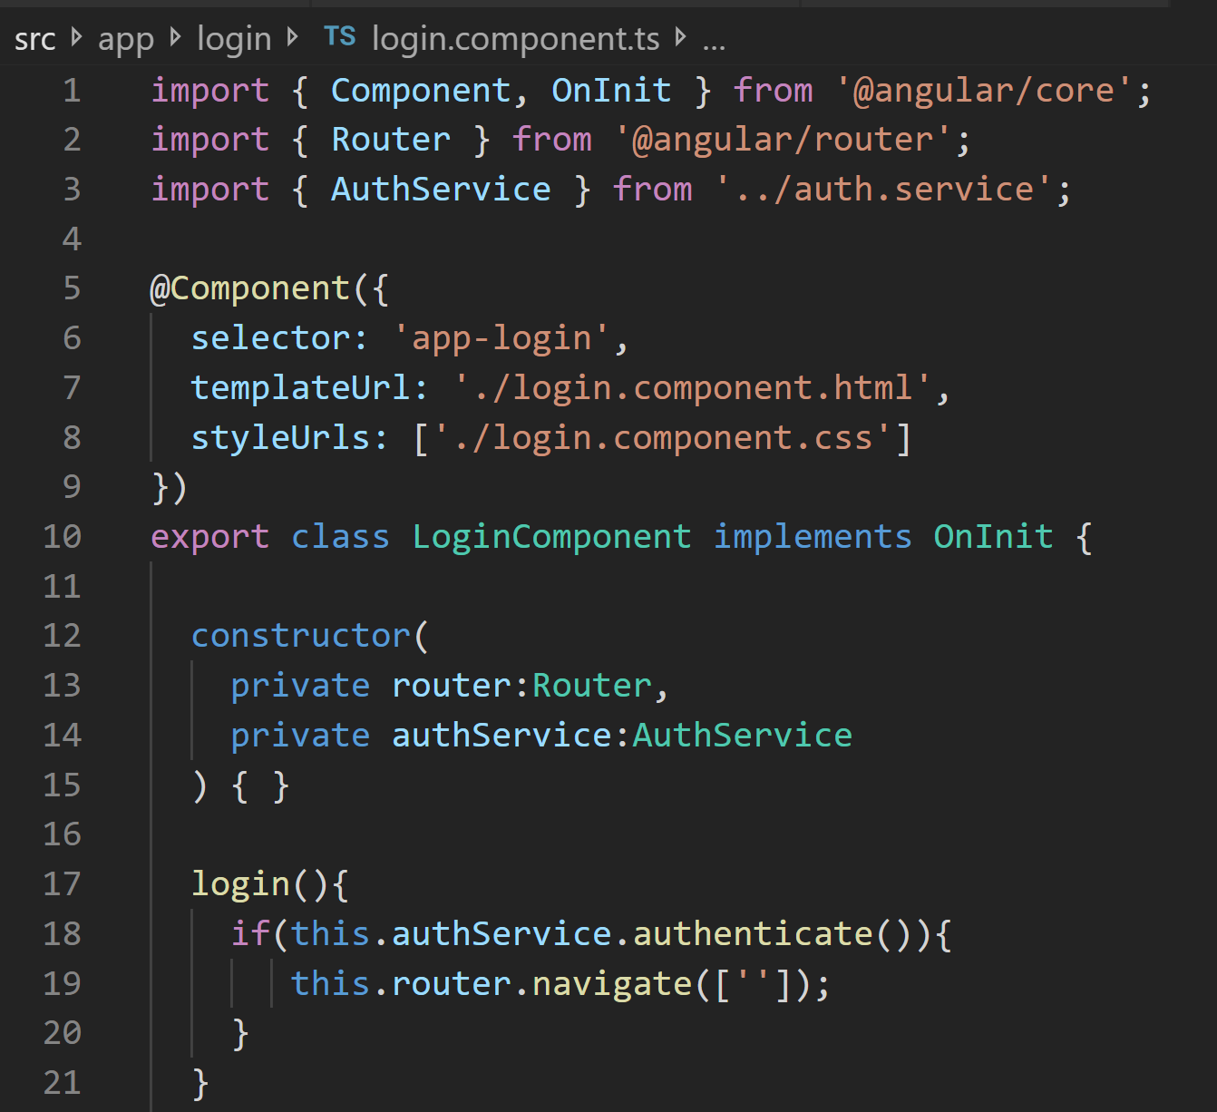
Login
#2 a
#2 b
Notes:
Instructions to Trainer:
Instructions to Facilitator:

Slide 18
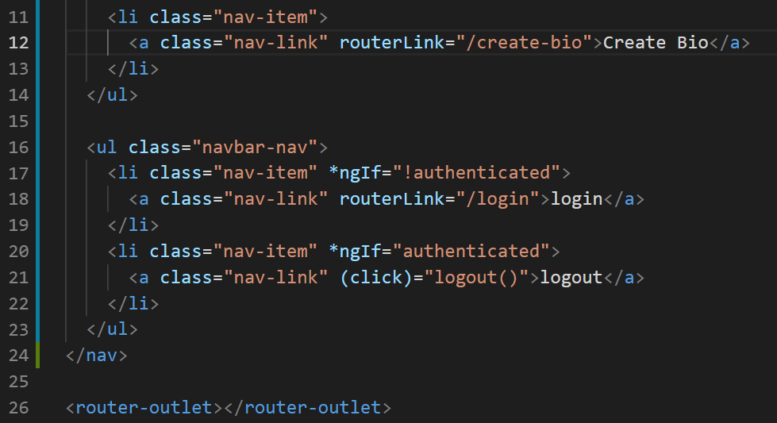
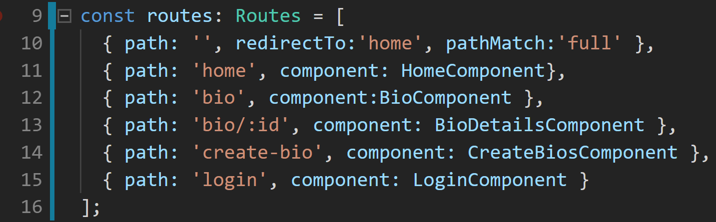
Login
#2 c
#2 d
Notes:
Instructions to Trainer:
Instructions to Facilitator:

Slide 19
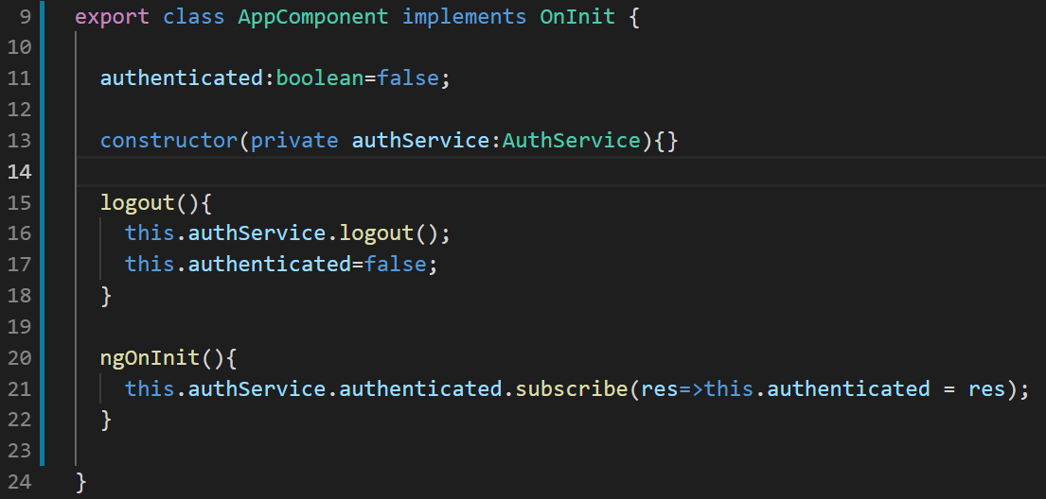
AppComponent
#3
Notes:
Instructions to Trainer:
Instructions to Facilitator:

Slide 20
Material

Slide 21
Material Design
Material Design (codenamed Quantum Paper) is a visual design language developed by Google.
It can be used to create digital experiences. It’s a set of principles and guidelines across platforms and devices for interactivity, motion and components that simplify the design workflow for teams designing their product.
Based on the Google Cards Design principles, Cards are surfaces that display content and actions on a single topic.
Angular Material brings the idea of Materials to Angular. It provides a library of pre-designed material tools with rich UI components

Slide 22
Material Design
Google Cards are surfaces that display content and actions on a single topic.
They are built with the following core principles:
Contained - A card is identifiable as a single, contained unit.
Independent - A card can stand alone, without relying on surrounding elements for context
Individual - A card cannot merge with another card, or divide into multiple cards.
Notes:
Contained - A card is identifiable as a single, contained unit.
Independent - A card can stand alone, without relying on surrounding elements for context
Individual - A card cannot merge with another card, or divide into multiple cards.

Slide 23
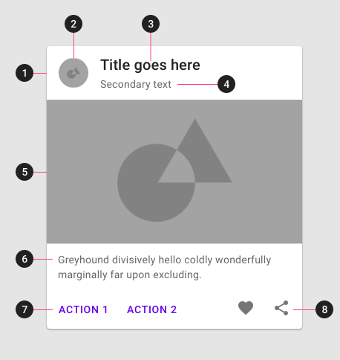
Card Anatomy
1. Container
Card containers hold all card elements, and their size is determined by the space those elements occupy. Card elevation is expressed by the container.
2. Thumbnail [optional]
Cards can include thumbnails to display an avatar, logo, or icon.
3. Header text [optional]
Header text can include things like the name of a photo album or article.
4. Subhead [optional]
Subhead text can include text elements such as an article byline or a tagged location.
5. Media [optional]
Cards can include a variety of media, including photos, and graphics, such as weather icons.
6. Supporting text [optional]
Supporting text include text like an article summary or a restaurant description.
7. Buttons [optional]
Cards can include buttons for actions.
8. Icons [optional]
Cards can include icons for actions.

Slide 24

Angular Material
Angular Material is a UI component library for Angular developers. Angular Material components help in constructing attractive, consistent, and functional web pages and web applications, while adhering to modern web design principles like browser portability, device independence, and graceful degradation – principles adopted from Google Cards.
Following are the key features of Angular Material:
Comprehensive, modern UI components that work across the web, mobile and desktop
Themable, for when you need to stay on brand or just have a favorite color. Accessible and internationalized so that all users are welcome.
Built by the Angular team to integrate seamlessly with Angular

Slide 25
Material Components
Angular Material comprises a range of components which implement common interaction patterns according to the Material Design specification.
Form Controls
Controls that collect and validate User Input
Navigation
Menus, SideNavs and Toolbars that organize your content
Layout
Essential building blocks for presenting your content
Buttons & Indicators
Buttons, Toggles, status and progress indicators
Popups and Modals
Floating components that can be dynamically shown / hidden
Data Table
Tools for displaying and interacting with tabular data

Slide 26
Angular Material Support
Install Material Toolkit to the Application
Configure animations; Import BrowserAnimationModule
Import the component modules
npm install --save @angular/material @angular/cdk @angular/animations
import {BrowserAnimationsModule} from '@angular/platform-browser/animations';
@NgModule({
...
imports: [BrowserAnimationsModule],
...
})
export class PizzaPartyAppModule { }
import {MatButtonModule, MatCheckboxModule} from '@angular/material';
@NgModule({
...
imports: [MatButtonModule, MatCheckboxModule],
...
})
export class PizzaPartyAppModule { }

Slide 27
Angular Material Support (Contd.)
Include a theme in styles.css; required
Include HammerJS for Gesture support on mobile devices
Some components (mat-slide-toggle, mat-slider, matTooltip) rely on HammerJS
Add Material icons in index.html; optional
npm install --save @angular/material @angular/cdk @angular/animations
npm install --save hammerjs
<link href="https://fonts.googleapis.com/icon?family=Material+Icons" rel="stylesheet">

Slide 28
Angular Material Support (Contd.)
OR Install everything will a CLI Menu driven command
ng add @angular/material

Slide 29
Angular Material Login Form
Install Angular Material
Create MaterialModule
Import into app.module.ts
Use Material in Login Form
Notes:
Instructions to Trainer:
Instructions to Facilitator:

Slide 30
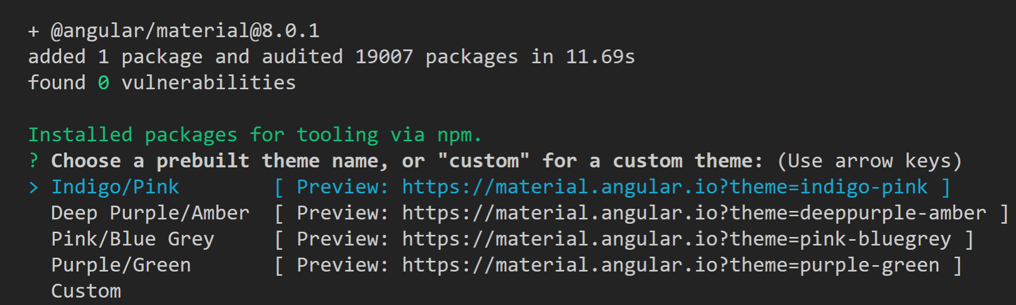
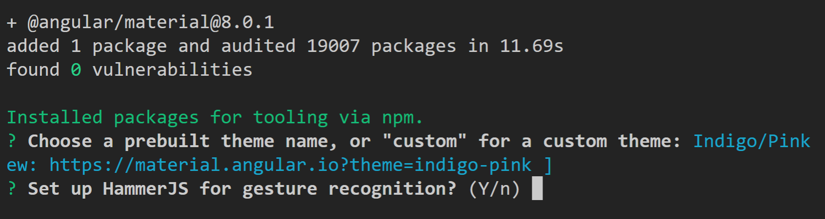
1 – using ng add @angular/material

Slide 31
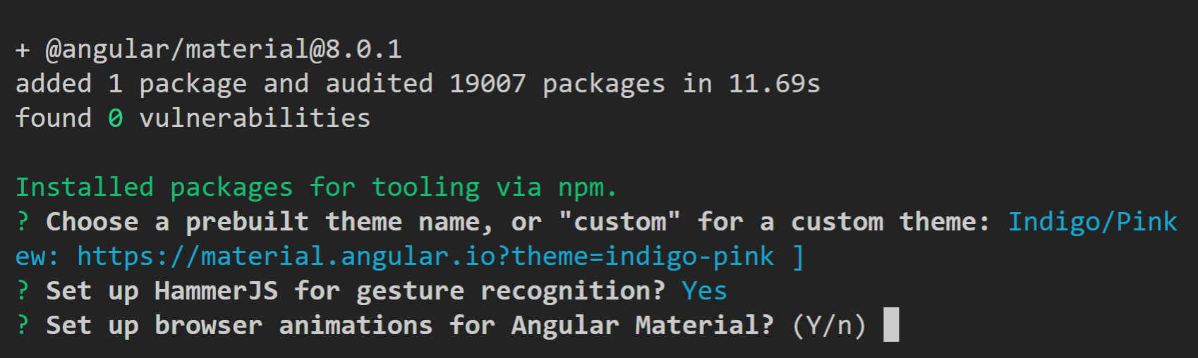
1 cont’d

Slide 32
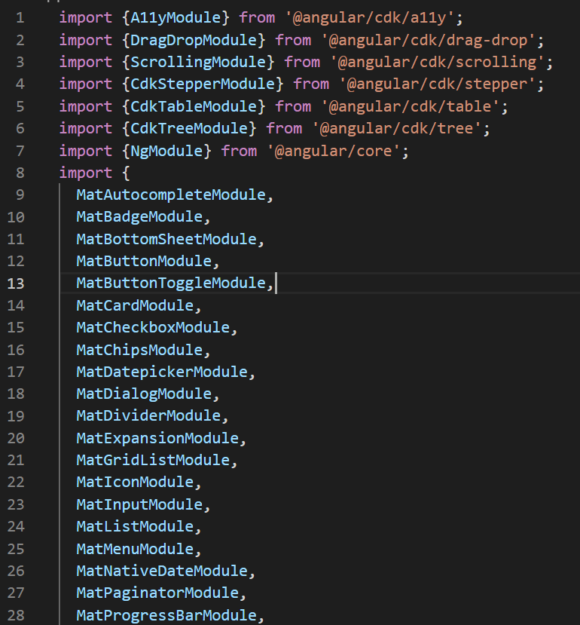
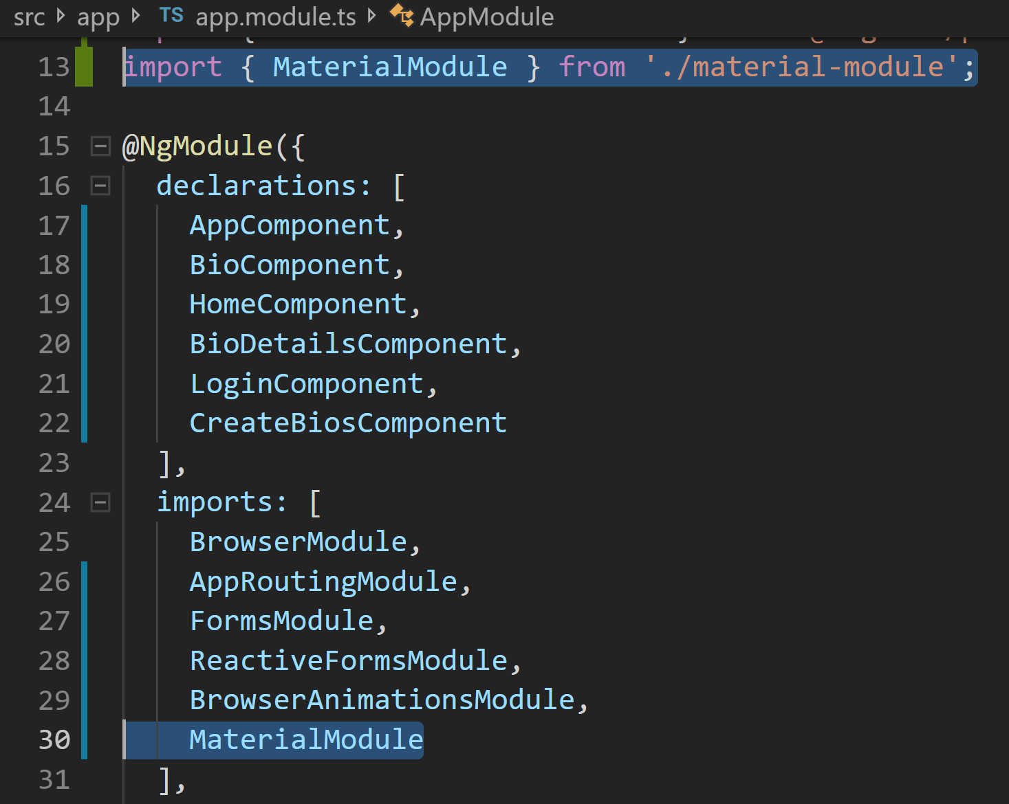
2
material-module.ts
app.module.ts
Truncated for brevity
See http://github.com/CognizatFSE/DevBios.git
Notes:
Instructions to Trainer:
Instructions to Facilitator:

Slide 33
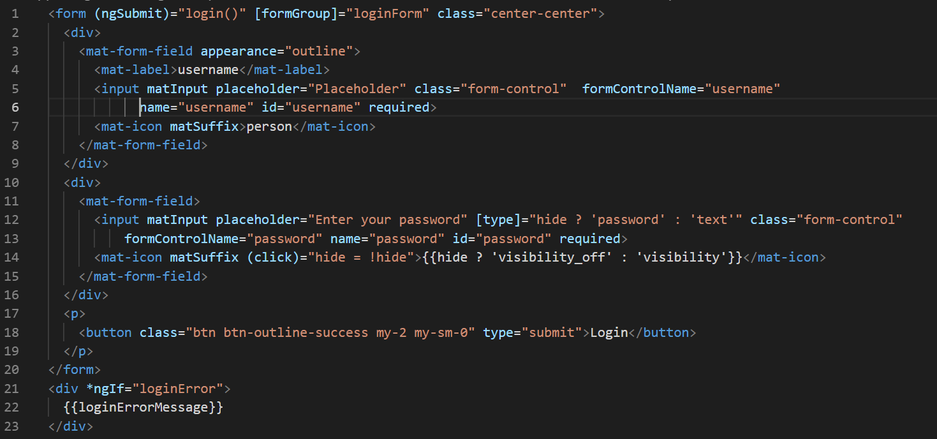
4
#1 a
#1 b
#1 c
Notes:
Instructions to Trainer:
Instructions to Facilitator:

Slide 34
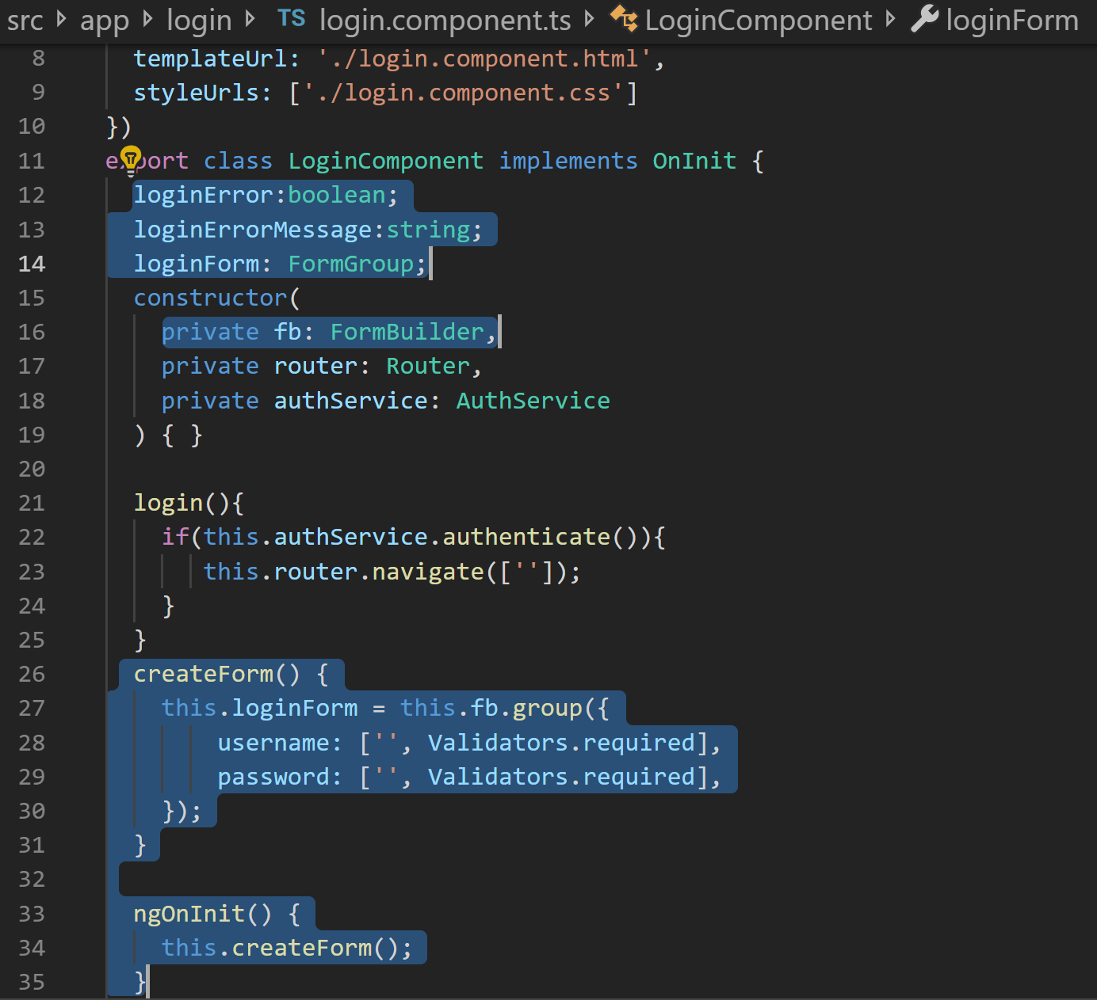
4 cont’d
Notes:
Instructions to Trainer:
Instructions to Facilitator:

Slide 35
Route Guards

Slide 36
Route Guards
Router Guards are like interceptors of to and from routes of traffic.
For example, this may be used in situations where, some routes are to be accessible, only after the user has logged in, or accepted the terms & conditions. Router Guards are perfectly suited to check these conditions and regulate access to routes.
Route Guards can also control, whether a user can leave a certain route. For example, say the user has typed information into a form on the page, but has not submitted the form. If they needed to leave the page, they would lose the information. You may want to prompt the user, if the he attempts to leave the route, without submitting or saving the information.
const routes: Routes = [
{ path: 'home', component: HomePage },
{
path: 'accounts',
component: AccountPage,
canActivate: [LoginRouteGuard],
canDeactivate: [SaveFormsGuard]
}
];

Slide 37
Route Guards
The canActivate routerguard guards the entry, while the canDeactivate guards the exit of a route.
These guards will be invoked respectively at the time of entry and exit of the guarded routes.
To implement these guards, implement the CanActivate and CanDeactivate interfaces, each having a similarly named method to be overridden.
These guard methods return a Boolean that indicates, if the approaching traffic can go past them.
The guard methods may also return an Observable<Boolean> if the output has to be produced asynchronously.
@Injectable()
export class TwoWayGuard implements CanActivate, CanDeactivate{
constructor(private loginService: LoginService) {}
canActivate() {
return this.loginService.isLoggedIn();
}
canDeactivate(component: AccountPage) {
return component.areFormsSaved();
}
}

Slide 38
Add Route Guards to Create Bio
Update Routes
Implement CanActivate and CanDeactivate in AuthService
Notes:
Instructions to Trainer:
Instructions to Facilitator:

Slide 39
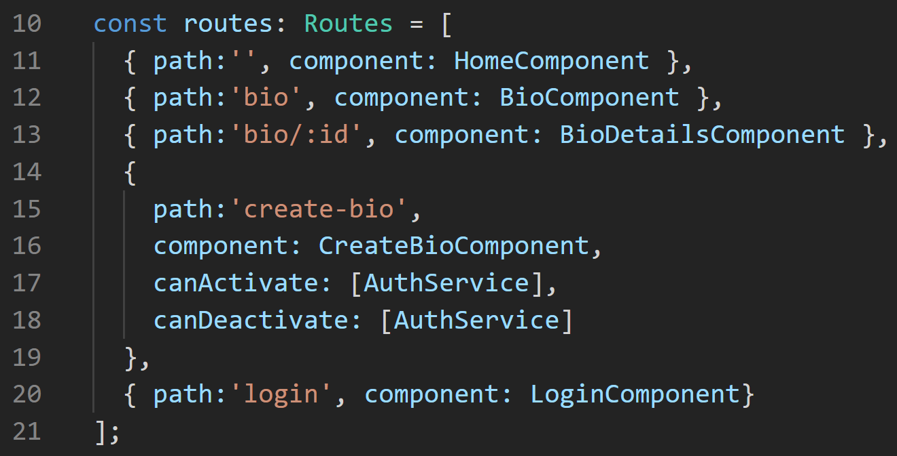
1. Update Route

Slide 40
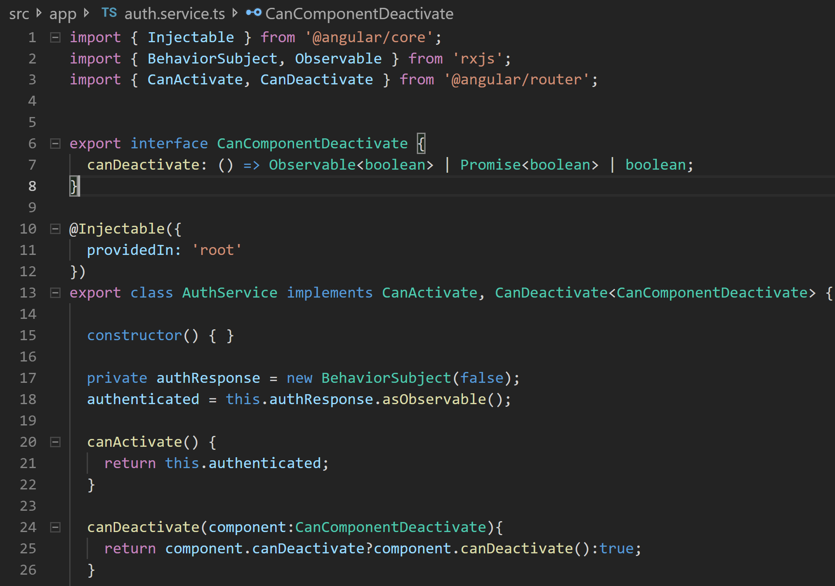
2. CanActivate CanDeactivate

Slide 41
Pipes

Slide 42
Introducing Pipes
The mechanism that Angular provides for filtering data is pipes.
A pipe’s primary task is to do data transformation of the input to the desired output.
Pipes are identifiable in templates by the presence of Pipes (pun intended ☺).
https://angular.io/api/common#pipes
@Component({
selector: 'product-price',
template: `<p>Total price of product is {{ price | currency }}</p>`
})

Slide 43
Introducing Pipes (Contd.)
A pipe can accept optional parameters. Parameters are sent as colon separated inputs after the pipe name.
@Component({
selector: 'product-price',
template: `<p>Total price is {{ price | currency :2:”CAD”}}</p>`
})

Slide 44
Introducing Pipes (Contd.)
Pipes are chainable. Output of one pipe may be fed as the input of a subsequent pipe.
@Component({
selector: 'product-price',
template: `<p>Price : {{ price|currency :2:”USD”|highlight:”Red” }}</p>`
})

Slide 45
Custom Pipes
Custom Pipes may be created to support adhoc application needs. A custom pipe has the following attributes:
A class that is decorated with @Pipe
Implements PipeTransform interface
Provides body for the transform method from the interface. The method is supplied with the arguments that are provided to the pipe
Returns a piped (also known as transformed) value
@Pipe({
name: 'formatFileSize'
})
export class Highlighter PipeTransform {
transform(textToHighlight: String, color: String): string {
return `<div style=“background-color:${color}”>
${textToHighlight}
</div> `;
}
}

Slide 46
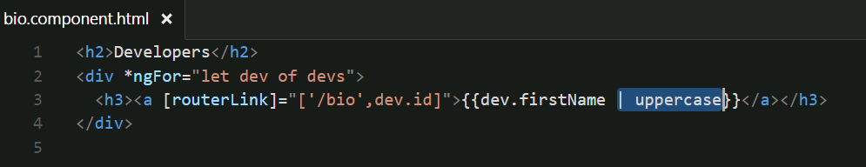
HelloAngular – Pipes
Create a pipe in the bio.component.html view to display the names in all caps.
Notes:
Instructions to Trainer:
Instructions to Facilitator:

Slide 47
Stateful Pipes
Pipes may be categorized into:
Stateless pipes are pure functions that flow input data through, without remembering anything, or causing detectable side-effects. Most pipes are stateless.
Stateful pipes are those which can manage the state of the data they transform. For instance, a pipe that creates an HTTP request, stores the response and displays the output, is called a stateful pipe. Stateful Pipes should be used cautiously.
Stateful pipes are used, when the input is not a literal but matches one of the following:
An Asynchronously updated value
An Observable or
A Promise

Slide 48
Stateful Pipes (Contd.)
The inbuilt async pipe is to be used in these cases. Without using an async pipe, such values will not process the output.
For building custom Stateful pipes, the attribute pure of the @Pipe decorator is to be set as false.
@Pipe({
name: 'animateNumber',
pure: false
})
export class AnimateNumberPipe implements PipeTransform {
... ...
}

Slide 49


Questions

Slide 50
Test Your Understanding
When are BehaviorSubjects used?
What are the advantages of Angular Material?
How do you implement a Route Guard?
When do you use a Pipe?
Notes:
Instructions to Trainer:
Instructions to Facilitator:

Slide 51
You have successfully completed
Angular 8 - Day 7
Forms, Pipes, and Route Guards

